Slide 1
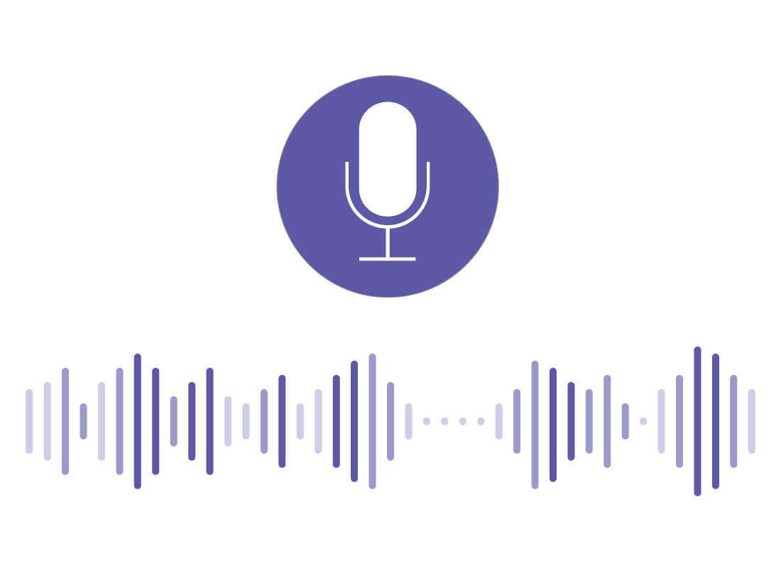
AI VOICE ASSISTANT

Slide 2
GROUP MEMBERS
AREEBA FATIMA
ROMAYSA
AQEEL
TEHREEMA

Slide 3

WHAT IS THIS?
A virtual assistant, also called an AI assistant or digital assistant, is an application program that understands natural language voice commands and completes tasks for the user.
using the power of artificial intelligence (AI). It works with voice and live voice conversion so it's great to search your queries and collect information according to your need.

Slide 4
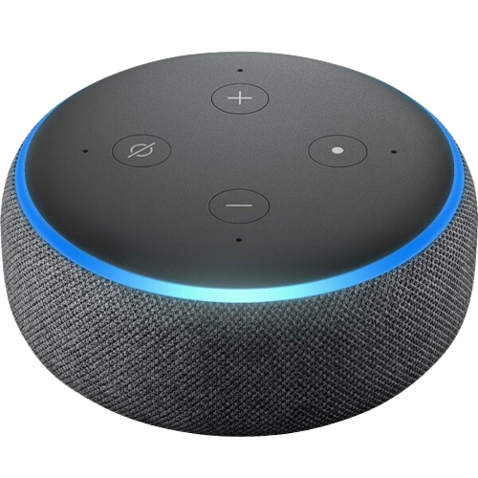
Through simple voice commands, we can ask them to play music, read the news, control our electronic devices, check our bank balance and carry out other tasks.
ALEXA
Alexa is a voice-controlled virtual assistant. She can play audio, control your smart home, answer questions and engage your favorite services to keep you organized, informed, safe, connected and entertained. As a product of Amazon, she's also your personal shopper.
main goal of Alexa :
Performing the requested task instantly and accurately
Can also connect with home appliances and remote devices
Google assistant is the feature which implement on the device called ALEXA

Slide 5
How it works?
AI voice assistants rely on several key technologies of python.
List of the modules used:
speech_recognition
pyttsx3
openai
os
Datetime
Wikipedia
webbrowser
These libraries provide convenient functionalities for different purposes, such as working with dates and times, accessing Wikipedia content, opening web pages, performing speech recognition, generating speech output, interacting with OpenAI models, and interacting with the operating system

Slide 6
Details of modules
The speech_recognition library provides a way to incorporate speech recognition functionality into Python programs. It supports multiple speech recognition engines and allows
you to capture audio from various sources (e.g., microphone or audio files) and convert it into text.
The pyttsx3 library is a cross-platform text-to-speech (TTS) library for Python. It enables you to convert text into spoken words by utilizing different speech synthesis engines. You can control the voice properties, such as rate and volume, and generate audio output from text.
The openai library is a Python package provided by OpenAI. It allows developers to interact with OpenAI models and services. For example, you can use it to make API requests to the GPT-3.5 language model, perform tasks like text completion, summarization, or translation.
The os module provides a way to interact with the operating system in a platform-independent manner. It allows you to perform various tasks like accessing and manipulating files and directories, executing system commands, and retrieving information about the environment in which the Python script is running.

Slide 7
The datetime module is part of the Python standard library and provides classes for working with dates and times. It allows you to manipulate dates, times, and time intervals, format them into strings, and perform calculations such as addition or subtraction.
The wikipedia module is a Python library that provides an interface to interact with the Wikipedia API. It allows you to search for articles, retrieve their content, and access other information from Wikipedia. You can search for specific articles, get summaries, retrieve sections, and more.
The webbrowser module provides a way to open web pages in the user's default web browser. It allows you to open URLs directly, open HTML files, and perform other browser-related operations programmatically.

Slide 8
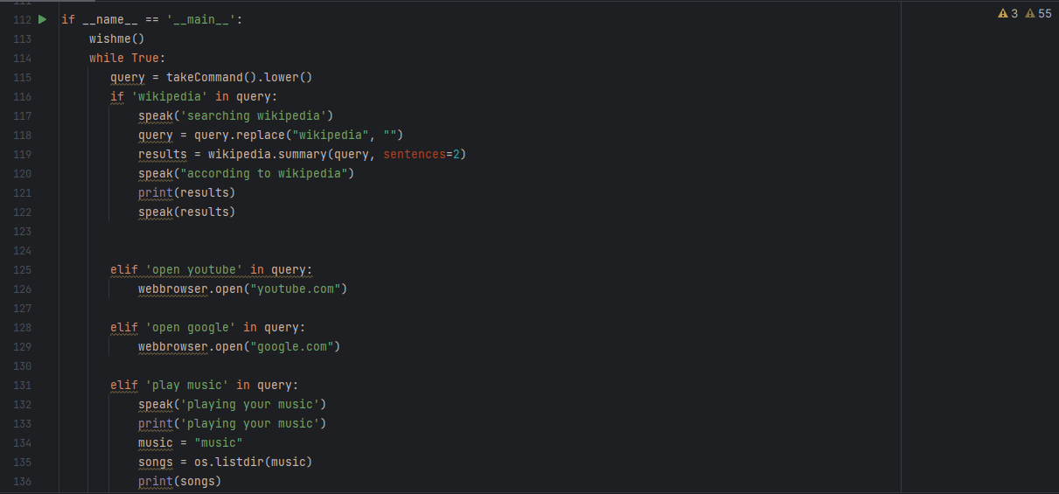
code
Briefly describe the code.
Here we used 3 functions:
WISHME
TAKE COMMNAD
MY AI
TAKE COMMAND: Listening, recognizing user command and make query
MY_AI :
Use openapi_key:
API stands for application programming interface. API's are used for software applications to send and receive data. API's can also connect one program to another, to share functionality. Interact with it without access to source code or documentation.

Slide 9
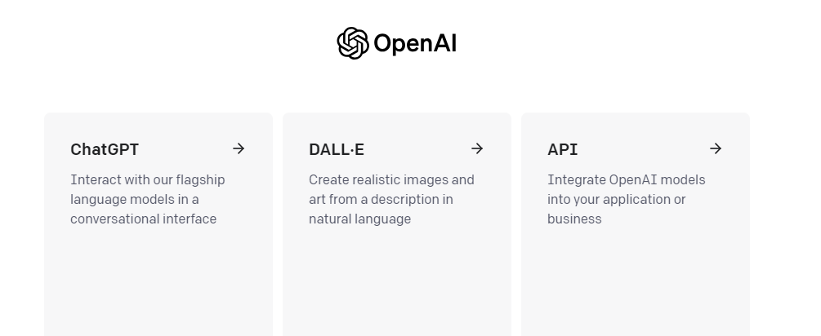
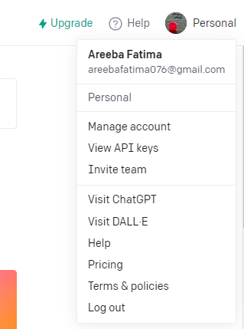
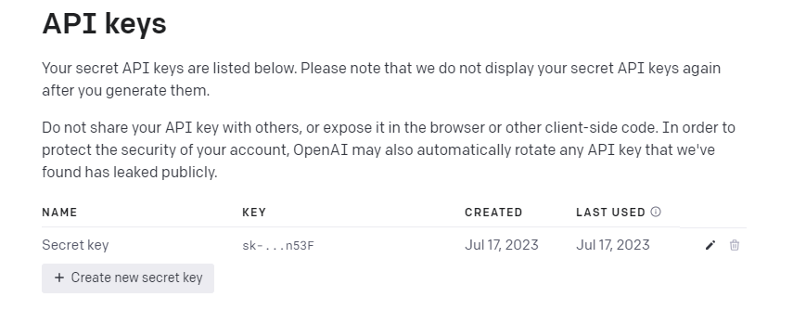
HOW TO GET OPENAPI_KEY
SinUp and login: https://openai.com/

Slide 10
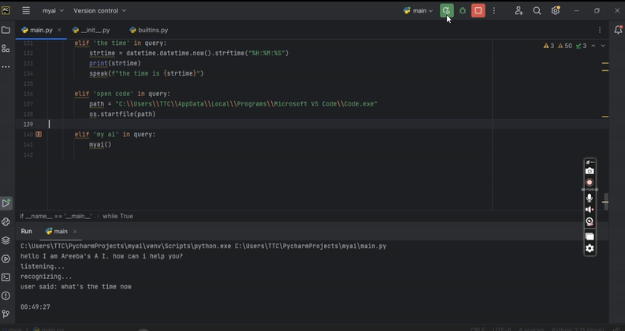
MAIN METHOD
CALL WISHME
Run the loop and getting queries
Match the queries and perform task according to the given command
Exit will terminate the loop
WORKING

Slide 11

Import chat-gdp
The model also used Voice Control for ChatGPT allows you to have voice conversations with ChatGPT. By calling myai function, it enables you to record and send your voice queries to ChatGPT, eliminating the need for typing. The AI's responses are subsequently read aloud, ensuring a smooth, auditory interaction. This makes it easy to interact with an intelligent conversational partner and explore the capabilities of advanced AI.
The programming languages used to create a ChatGPT voice assistant depend on the specific implementation. However, we used python and its modules to do it.

Slide 12
Features
Chat GPT Voice Assistant offers several features that make it a useful tool for everyday use. Let’s explore some of its key features:
Voice Commands:
One of the main features of Voice Assistant is that it responds to voice commands. Users can ask it to perform a variety of tasks, such as setting reminders, making calls, and even searching the internet. The voice recognition technology used by Chat GPT Voice Assistant is highly accurate and can understand a wide range of accents and languages.
Efficiency: By quickly providing relevant information or completing tasks on behalf of the user, voice assistants can save time and increase productivity.

Slide 13
Multilingual support:
Chat GPT Voice Assistant supports multiple languages, making it accessible to users from different parts of the world. This feature enhances the accessibility of the assistant and makes it a useful tool for people who speak different languages.
Hands-free operation: Voice assistants enable users to perform tasks without using their hands, which can be particularly helpful when multitasking or in situations where manual input is not feasible.
Integration: They can connect with various devices and services, enabling users to control smart homes, manage calendars, and access a wide range of applications through a single interface.

Slide 14
THANKYOU

